Slide 1
Mobile Internet Protocol (or Mobile IP)

Slide 2
Mobile IP HELLO
Mobile IP is a communication protocol (created by extending Internet Protocol, IP) that allows the users to move from one network to another with the same IP address. It ensures that the communication will continue without user’s sessions or connections being dropped

Slide 3
Terminologies:
Mobile Node (MN): It is the hand-held communication device that the user caries e.g. Cell phone.
Home Network: It is a network to which the mobile node originally belongs to as per its assigned IP address (home address).

Slide 4
Terminologies:
Home Agent (HA): It is a router in home network to which the mobile node was originally connected
Home Address: It is the permanent IP address assigned to the mobile node (within its home network).

Slide 5
Terminologies:
Foreign Network: It is the current network to which the mobile node is visiting (away from its home network).
Foreign Agent (FA): It is a router in foreign network to which mobile node is currently connected. The packets from the home agent are sent to the foreign agent which delivers it to the mobile node

Slide 6
Terminologies:
Correspondent Node (CN): It is a device on the internet communicating to the mobile node.
Care of Address (COA): It is the temporary address used by a mobile node while it is moving away from its home network.

Slide 7
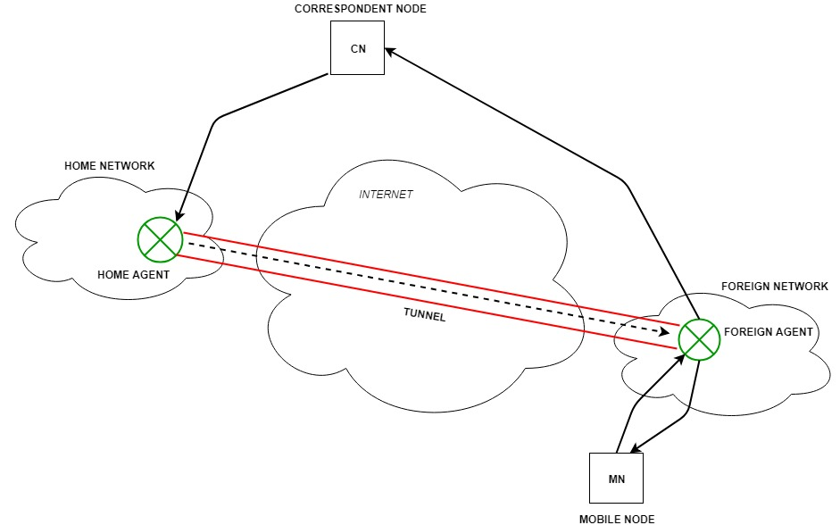
MOBILE IP

Slide 8
Key Mechanisms in Mobile IP:
Agent Discovery:
Agent Registration:
Tunneling:

Slide 9
Agent Discovery:
Agents advertise their presence by periodically broadcasting their agent advertisement messages. The mobile node receiving the agent advertisement messages observes whether the message is from its own home agent and determines whether it is in the home network or foreign network

Slide 10
Agent Registration:
Mobile node after discovering the foreign agent, sends registration request (RREQ) to the foreign agent. Foreign agent in turn, sends the registration request to the home agent with the care-of-address. Home agent sends registration reply (RREP) to the foreign agent. Then it forwards the registration reply to the mobile node and completes the process of registration.

Slide 11
Tunneling:
It establishes a virtual pipe for the packets available between a tunnel entry and an endpoint. It is the process of sending a packet via a tunnel and it is achieved by a mechanism called encapsulation. It takes place to forward an IP datagram from the home agent to the care-of-address. Whenever home agent receives a packet from correspondent node, it encapsulates the packet with source address as home address and destination as care-of-address

Slide 12
Route Optimization in Mobile IP:
The route optimization adds a conceptual data structure, the binding cache, to the correspondent node. The binding cache contains bindings for mobile node’s home address and its current care-of-address. Every time the home agent receives a IP datagram that is destined to a mobile node currently away from the home network, it sends a binding update to the correspondent node to update the information in the correspondent node’s binding cache. After this the correspondent node can directly tunnel packets to the mobile node.

